Slide 1
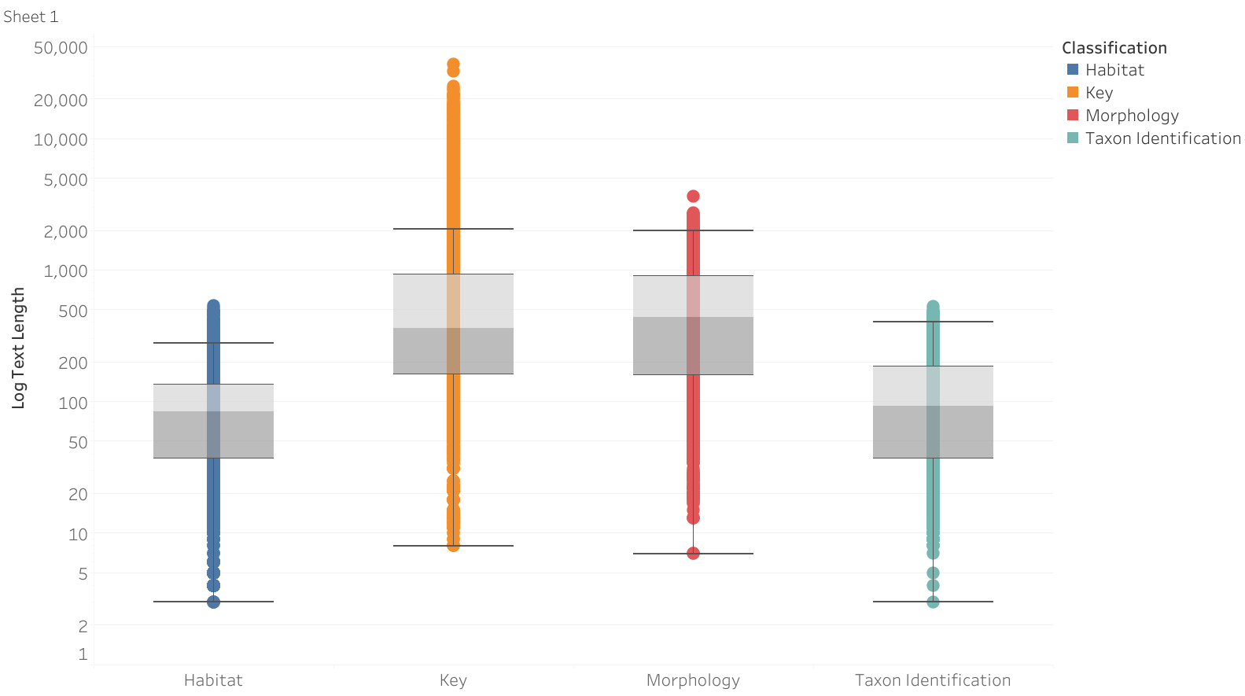
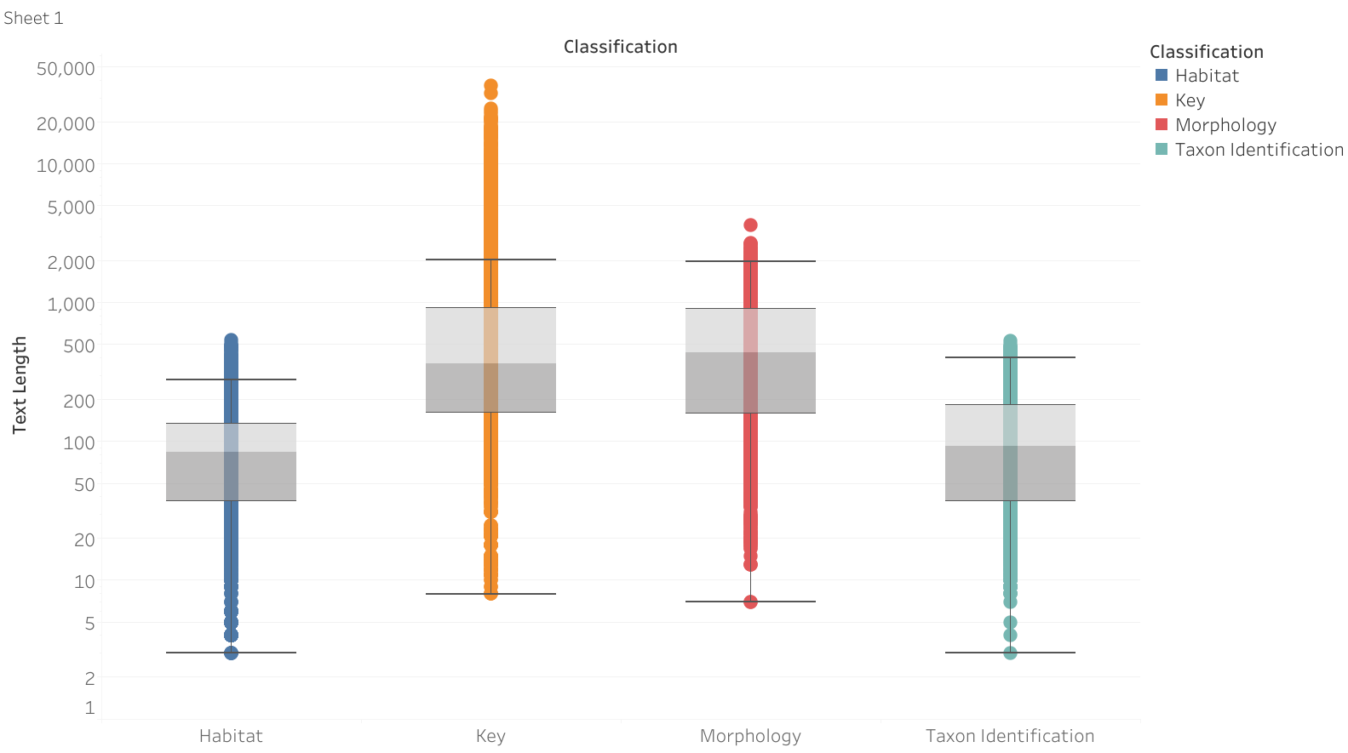
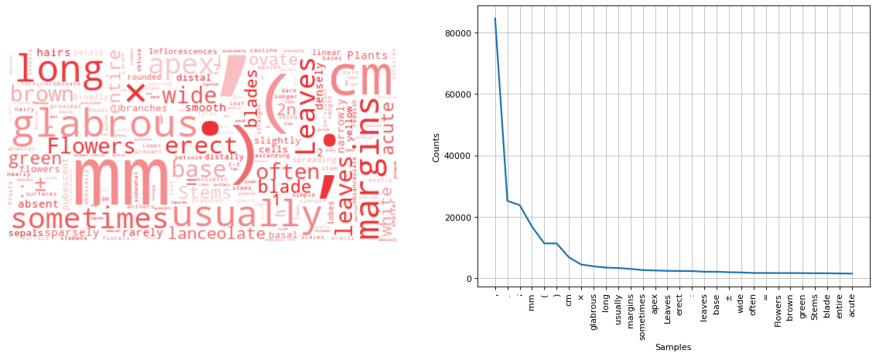
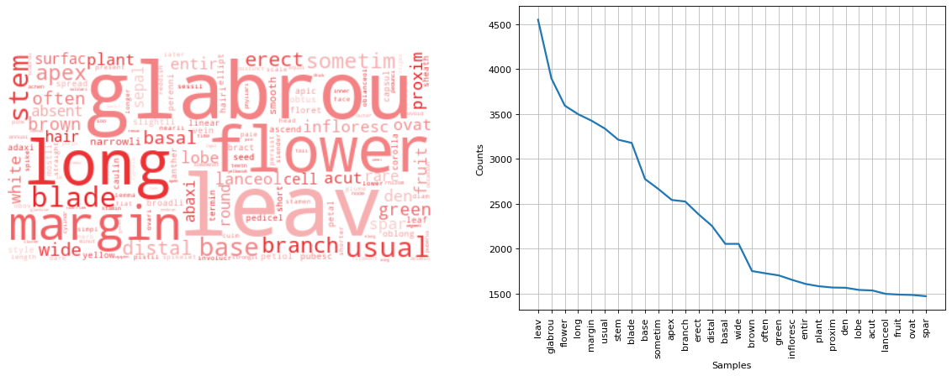
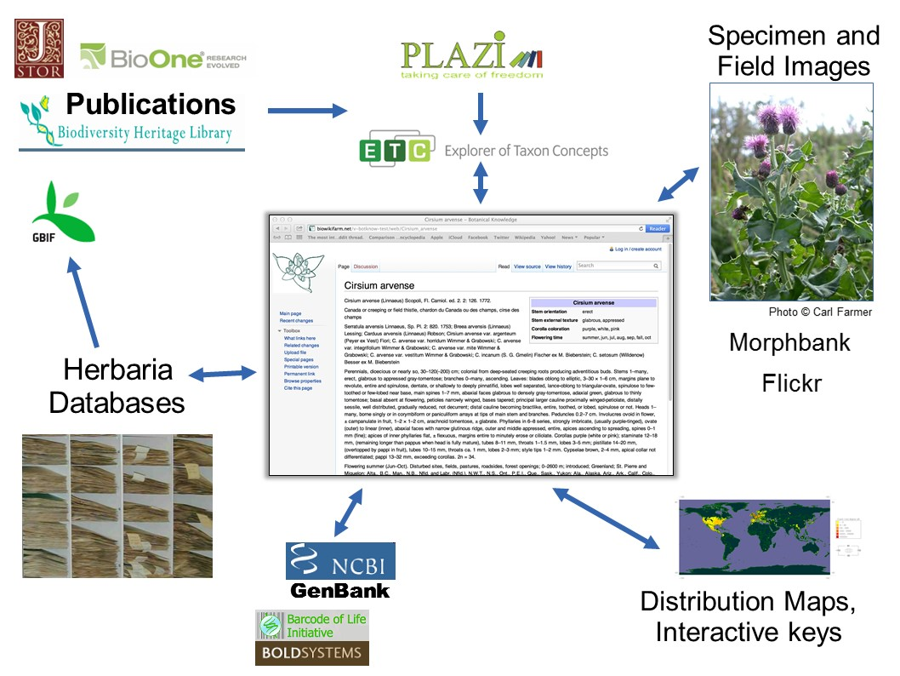
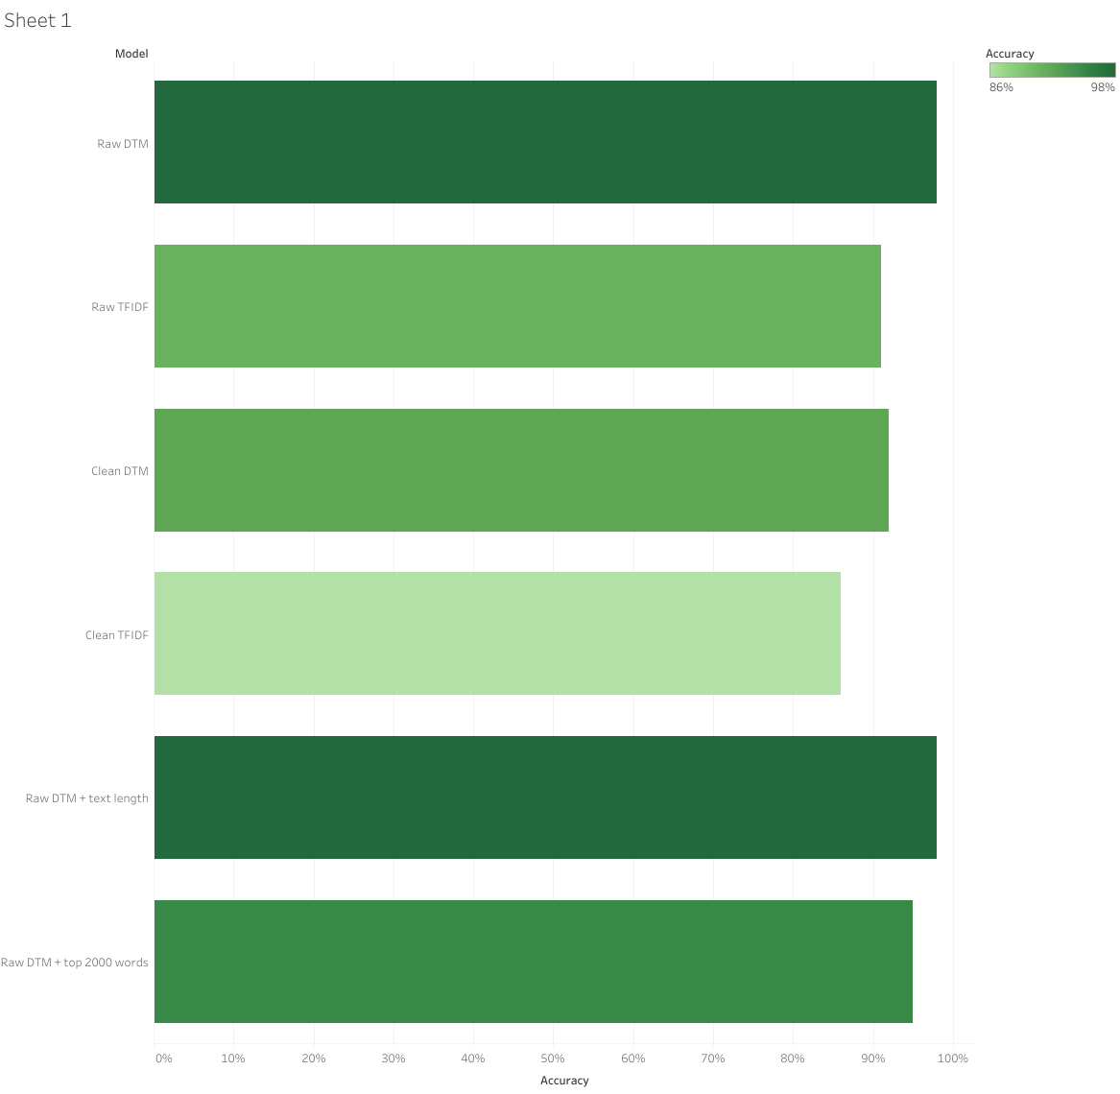
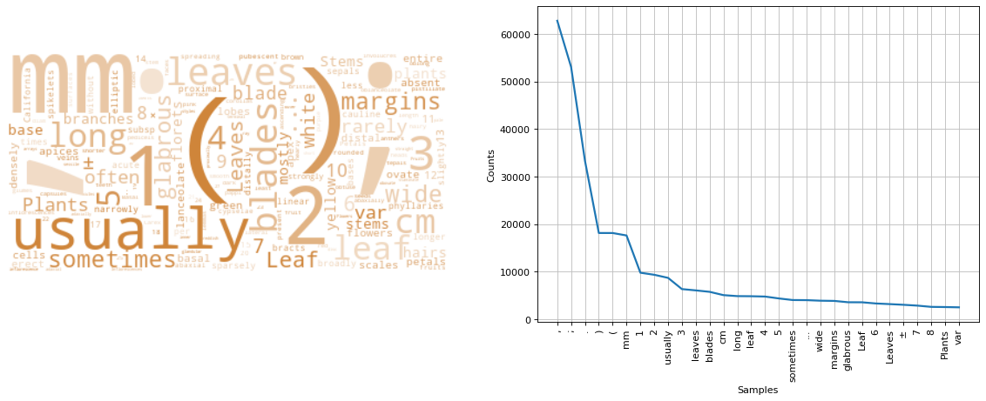
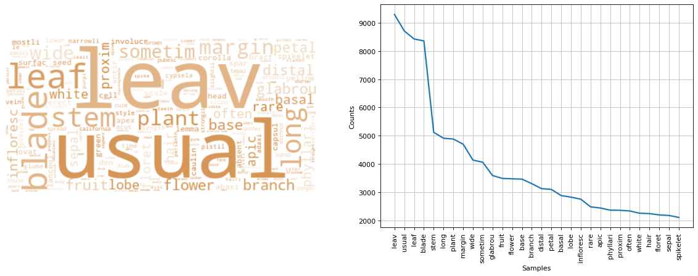
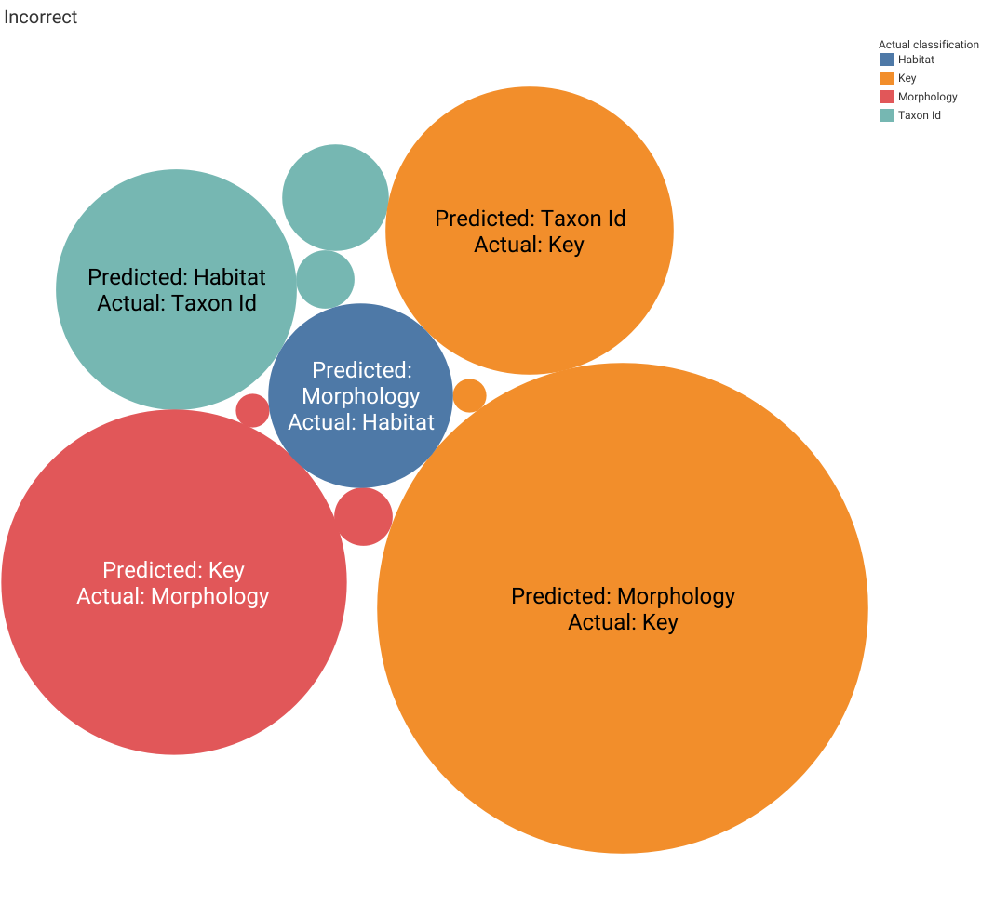
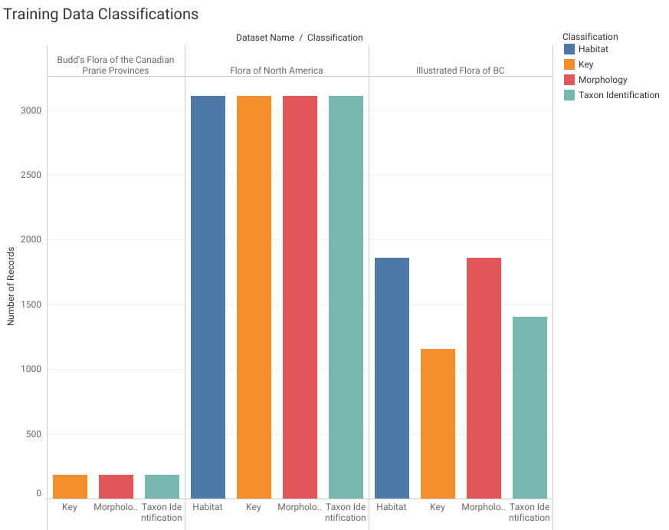
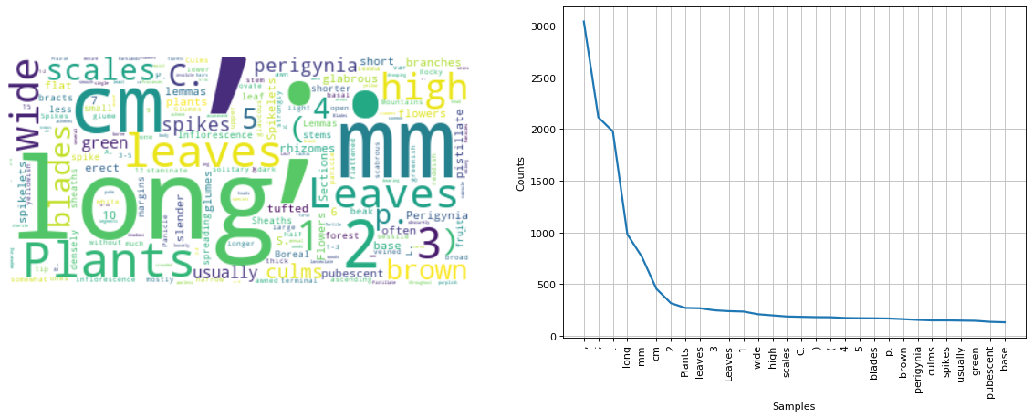
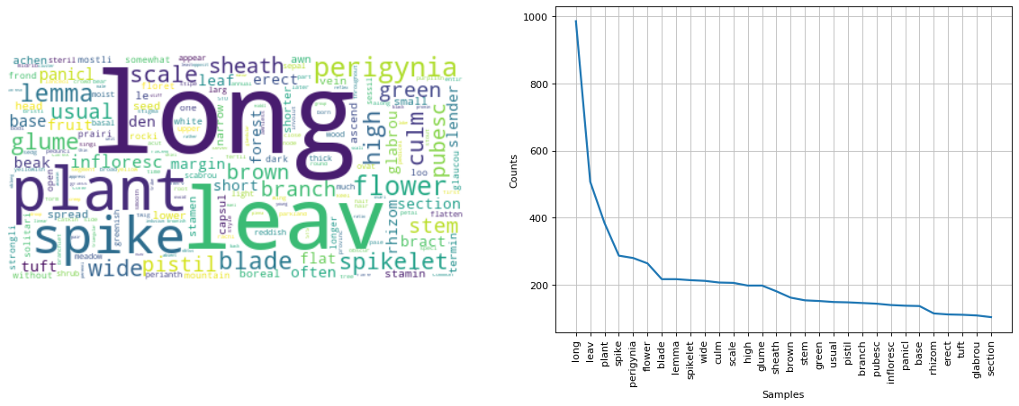
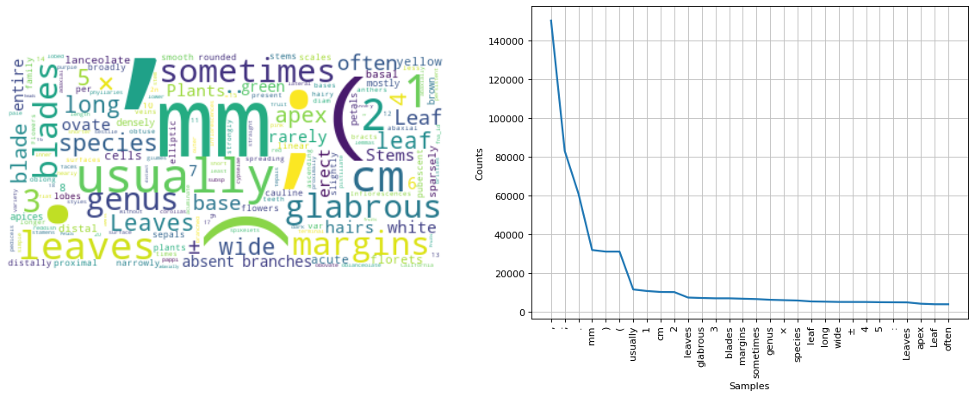
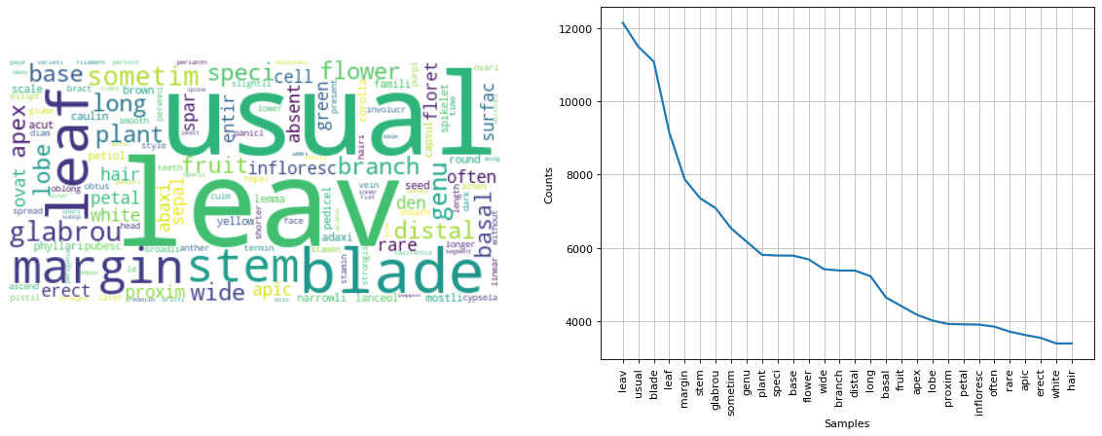
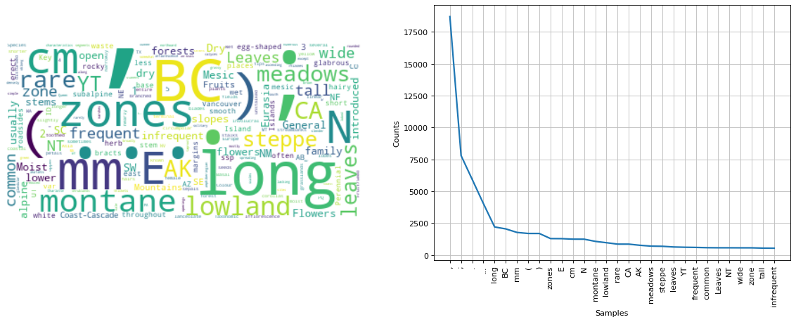
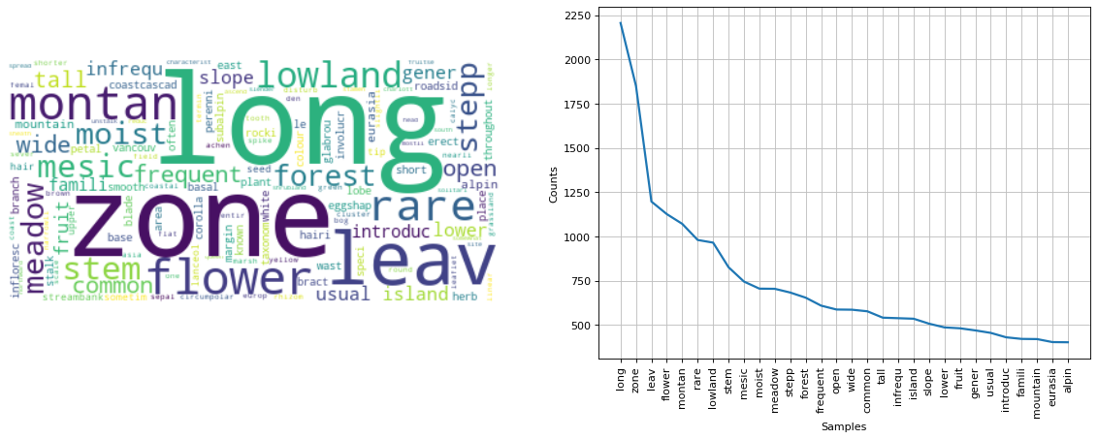

Flora Prepper: Preparing floras for morphological parsing and integration
Jocelyn Pender, Agriculture and Agri-Food Canada, Ottawa, Canada, jocelyn.pender@canada.ca
Rationale
Results
Text Length
The future of floras is online and integrated. But how do we get legacy botanical texts rapidly parsed and integrated with other content?
Content types must be annotated (i.e., text tagged as names, morphology, discussion or distribution content).
Previous floral content annotation projects have developed software for manual annotation (Sauter et al. 2012) or have automated the process via regular expressions (Hamann et al. 2014).
Word Clouds by Classification
Text length distributions are overlapping, at least in our training dataset.
Taxon identification
Morphology
Raw
Clean
Model Performance (Q1-Q3)
A programmatic and model-based solution to text annotation would be more modular (i.e., easier to implement in programmatic workflows) and flexible.
Flora prepper is a pilot project to build a text classifier to prepare three floras for downstream data preparation, parsing and integration.
Model Performance Model | Accuracy
Raw DTM | 98%
Raw TFIDF | 92%
Clean DTM | 92%
Clean TFIDF | 86%
Raw DTM + text length | 98%
Raw DTM + top 2000 words | 95%
Habitat
Key
Raw
The vision of an integrated digitally available Flora of Canada. Top image via: Flora of North America Editorial Committee, eds. 1993+ Vol. 5. Bottom image via G. Levin & J. Macklin 2017.
Incorrectly Classified Text
Sample Texts
Predicted: Morphology, Actual: Key
1 Calyptra minute, tightly adherent at or near the apex of the capsule, persistent; capsule…
Predicted: Taxon ID, Actual: Key
Key to the Species and Taxonomic Notes
Predicted: Key, Actual: Morphology
﻿Leaves Stem leaves compound, divided 1-3 times without bulbils in axils; leaflets more than 5 times as long as broad…
Predicted: Habitat, Actual: Taxon Id
﻿California poppy
Predicted: Morphology, Actual: Habitat
﻿Base and trunks of trees
Clean
Methods
Questions
Most Informative Features
of the raw DTM model
Q1: Can we build a useful machine learning model to classify text strings into one of four classifications (taxon identification, morphology, habitat or key)?
Q2: Are punctuation, numbers, white space, brackets, symbols and word endings meaningful for floral text classification?
Q3: Is the length of text strings to be classified meaningful?
Q4: Can a model trained on floras be applied to previously unseen floras (i.e., are floras representative of each other)?
 | Words (i.e., features) in order of importance
Taxon identification | colon, comma, rank designations* (variety, family, species, genus), brackets, period, semi-colon *artefact of FNA taxon id strings. Not all floras will contain these.
Morphology | glabrous, multiplication symbol (×), leaves, units (cm, mm), brackets, semi-colon, period, comma
Habitat | habitat descriptors (lowland, dry, montane, zones), directions (E, N), BC✢, period, semi-colon, comma ✢ artefact of dataset Illustrated Flora of BC
Key | key, numbers (e.g., 2,1), usually, brackets, units (e.g., mm), period, semi-colon, comma
Data
How important is the training set to model performance? (Q4)
Three floras were ingested and split into text fragments:
Flora of North America (text already tagged)
Budd’s Flora of the Canadian Prairie Provinces (text manually tagged)
Illustrated Flora of British Columbia (text already tagged)
Training data classification buckets were balanced.
Word Frequency Distribution by Flora
Training set
Testing set
A model trained on 2 floras and tested on the third had an accuracy rate of 80%, precision of 85% and an F1 score of 80%.
Term frequency distributions are similar among floras. Punctuation markers are the most common tokens, followed by measurement units, and plant structure descriptors (leaf, stem, flower).
Discussion
Raw
Clean
Q1: Can we build a classifier to prepare floras?
A1: Yes, with sklearn building a classifier is possible. The pain points:
Building a sufficiently large training set (i.e., finding annotated data)
Importing, reformatting, balancing and shuffling the data
Deciding how to clean the dataset
Q2: Is text cruft meaningful for classification of flora text strings?
A2: Yes. A 6% drop in accuracy was seen when text was stripped of cruft. Important cruft features included colons, commas, etc. (see results).
Q3: Is the length of text strings meaningful?
A3: No. This may be an artefact of our training dataset. Flora of North America keys were concatenated into one string per key. Changing the pre-processing of this dataset should change the results.
Q4: Can a model be applied to never-before-seen floras?
Sure, however a large drop (e.g., 18%) in accuracy should be expected. With an 80% accuracy rate, human intervention would be required to adequately prepare floras for downstream use. A small training set per flora should be manually developed to make the flora prepper model fit-for-use. Investigations to determine the minimum size of this training set would be a logical next step (~600 statements, as was seen in Budd’s flora, is adequate).
Other discussion points:
The accuracy of the model is unusually high. When the proportion of Flora of North Am. and B.C. data was reduced by dataset trimming, accuracy decreased. Is overfitting occurring?
This model relies too heavily on artefacts of the training dataset (rank words) to classify taxon identification strings. Instead, they could be annotated using other tools, like gnfinder (github.com/gnames/gnfinder)
Budd’s Flora
Images above from, respectively: Stella Books, Amazon (Thrift Books), Amazon (thebookcommunity)
Flora of North Am.
Workflow
The entire workflow was built in Python 3 (incl. text pre-processing and model building). See GitHub repo for specific packages used.
Illus. Flora of BC
Data was either kept raw or cleaned. Models were run with either a Document-Term Matrix (DTM) or a Term–Frequency Inverse-Document-Frequency (TFIDF) matrix.
Cleaning regime:
Numbers removed
Short words removed
Punctuation removed
Words stemmed and lemmatized
A model was run with text length included as a feature.
Models were built and tested using MultinomialNB from sklearn. MultinomialNB is suitable for classification with discrete features (e.g., word counts for text classification).
Data credits & references: see github.com/jocelynpender/flora-prepper
Image credits
Flora of North America Editorial Committee, eds. 1993+ Vol. 5. Flora of North America North of Mexico. 19+ vols. New York and Oxford.
Levin, G. & Macklin, L. 2017. The Flora of North America: Moving from Hard Copy to Digital Information Sharing. International Botanical Congress.
Spratt, A. Red and white flowers from above. https://unsplash.com/photos/nrzFZ3UBJ9o
Book images:
https://stellabooks.com/books/no-author/flora-of-north-america-volume-27-bryophytes-mosses-part-1/1206586?selSortBy=srdd&page=3&route=category-234
https://www.amazon.com/Budds-Canadian-prairie-provinces-Publication/dp/0660102331
https://www.amazon.ca/Illustrated-Flora-British-Columbia-Diapensiaceae/dp/B00H89DA7G

